Slide 1
Program
MineOperate Technical Level 1
Configuring OEM interfaces
Edgar Sepulveda
Global Technical Manager, MineOperate
Date 10/10/2022
Version 1.3

Slide 2

Purpose
This session shows how to configure OEM interfaces in OP Pro.
At the end of this module, you will:
where to find and how to load the xml OEM interfaces configuration files.
know how to enable OP Pro OEM related features.
Know how to troubleshoot OEM interfaces.

Slide 3
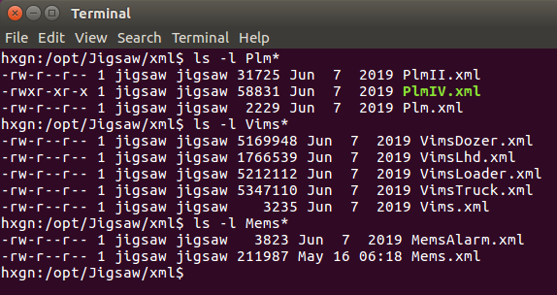
Configuring OEM Interfaces
Load sensor configurations for OEM interface using xml files in
/opt/Jigsaw/xml/
and running xml_loader Tool
/opt/Jigsaw/Tools/xml_loader -database jmineops PlmII.xml

Slide 4
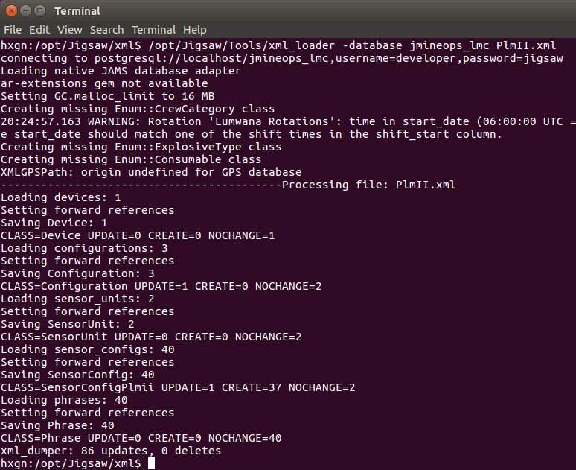
Configuring OEM Interfaces
Load sensor configurations for OEM interface using xml files in
/opt/Jigsaw/xml/
and running xml_loader Tool
/opt/Jigsaw/Tools/xml_loader -database jmineops PlmII.xml

Slide 5
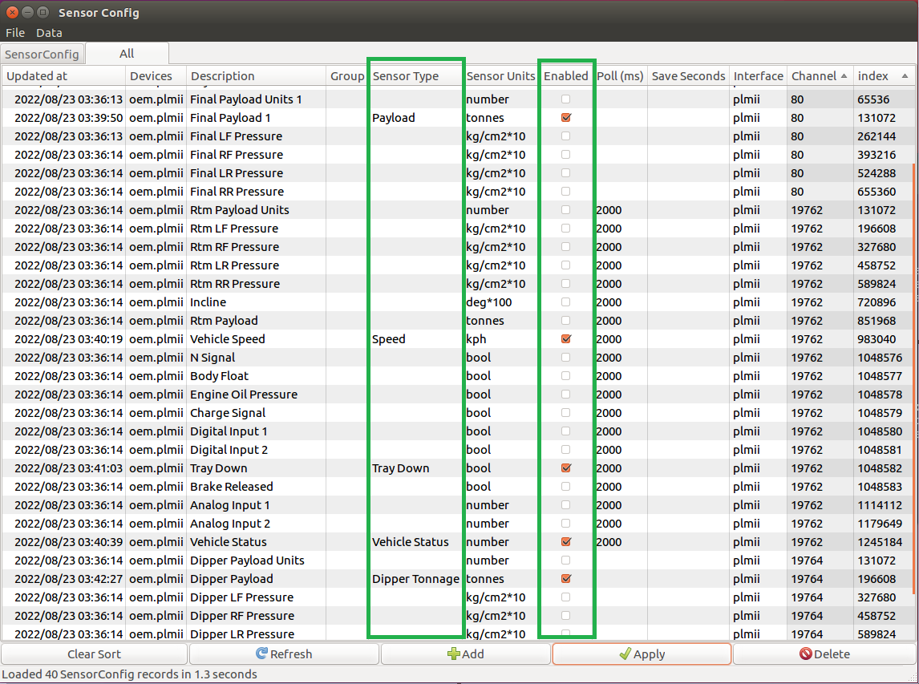
Configuring OEM Interfaces
Add Sensor Type and Select Enable in Sensor Configs view to active a sensor in OP Pro.

Slide 6
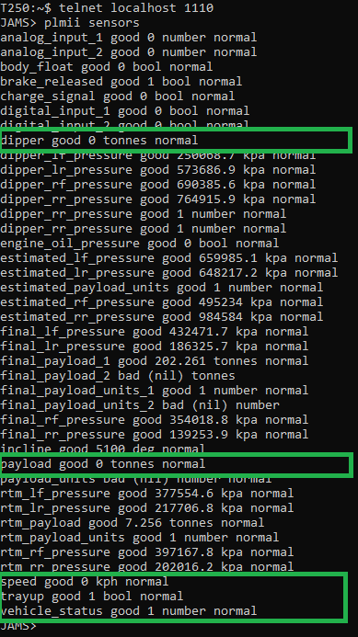
Configuring OEM Interfaces
Check that JAMS is receiving OEM values for configured sensors.

Slide 7
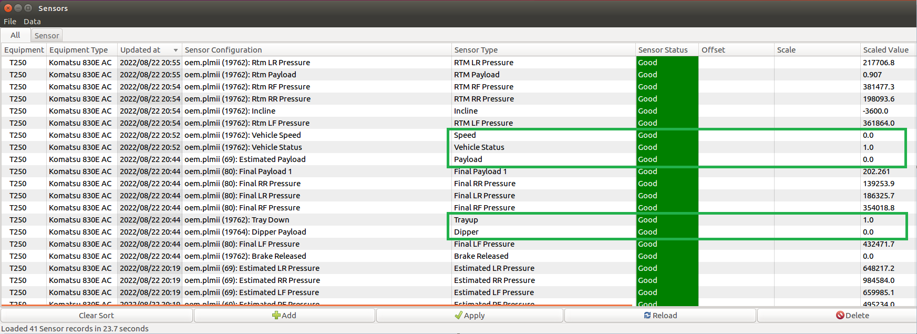
Configuring OEM Interfaces
Check that OP Pro Manager is showing OEM interface values for configured sensors.

Slide 8
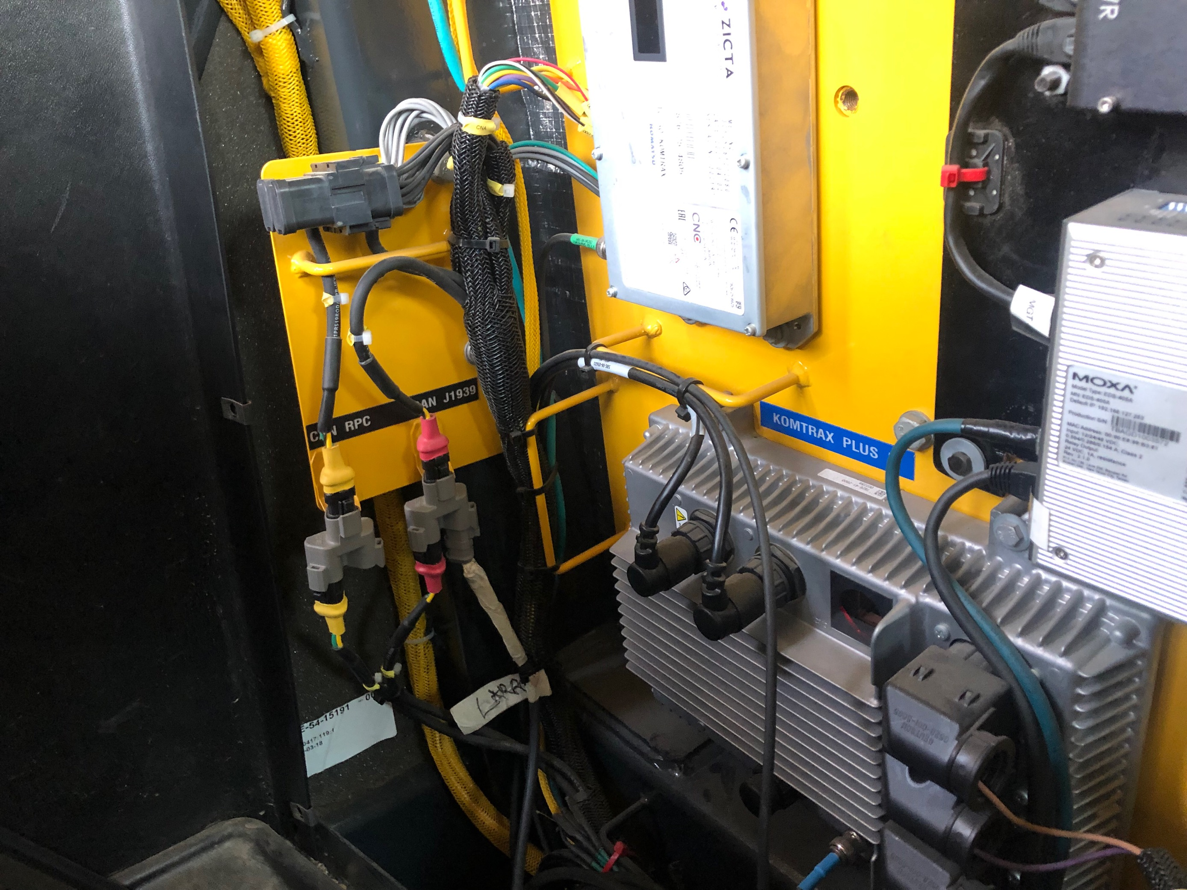
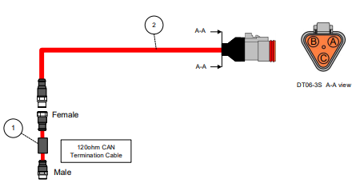
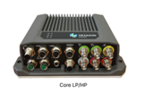
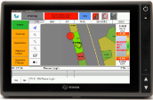
Troubleshooting OEM interfaces
JAMS

Slide 9
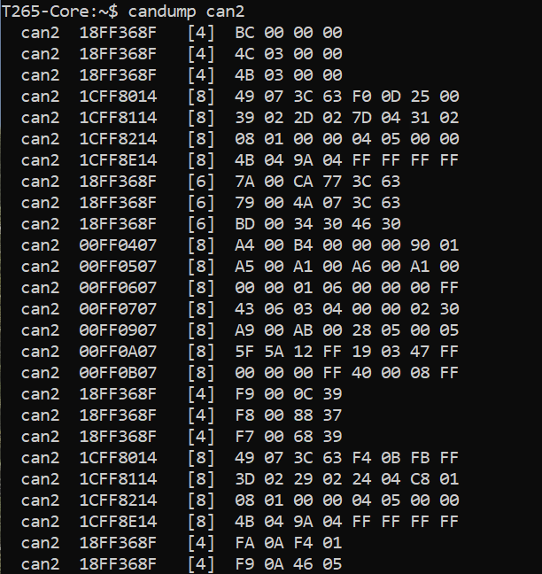
Troubleshooting CAN OEM interfaces
Check that CAN port in Core hub is receiving raw data from OEM interface.
candump can2

Slide 10
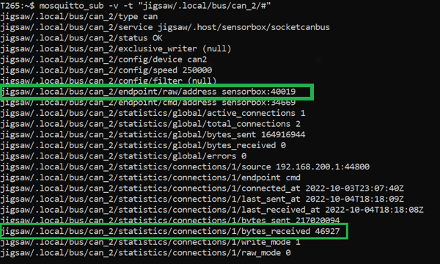
Troubleshooting CAN OEM interfaces
Check that Display9 is receiving CAN data from Core hub.
mosquitto_sub -v -t “jigsaw/.local/bus/can_2/#”
JAMS

Slide 11
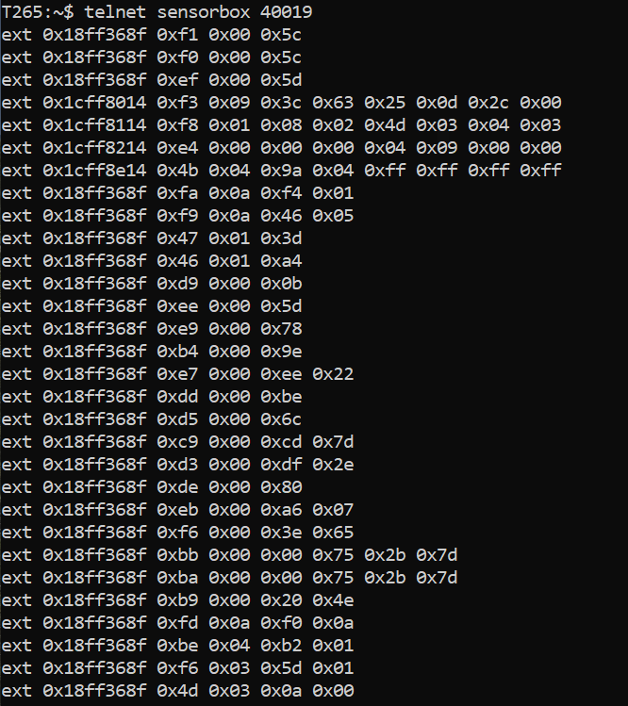
Troubleshooting CAN OEM interfaces
Check that Display9 is receiving CAN data from Core hub.
telnet sensorbox 40019
JAMS

Slide 12
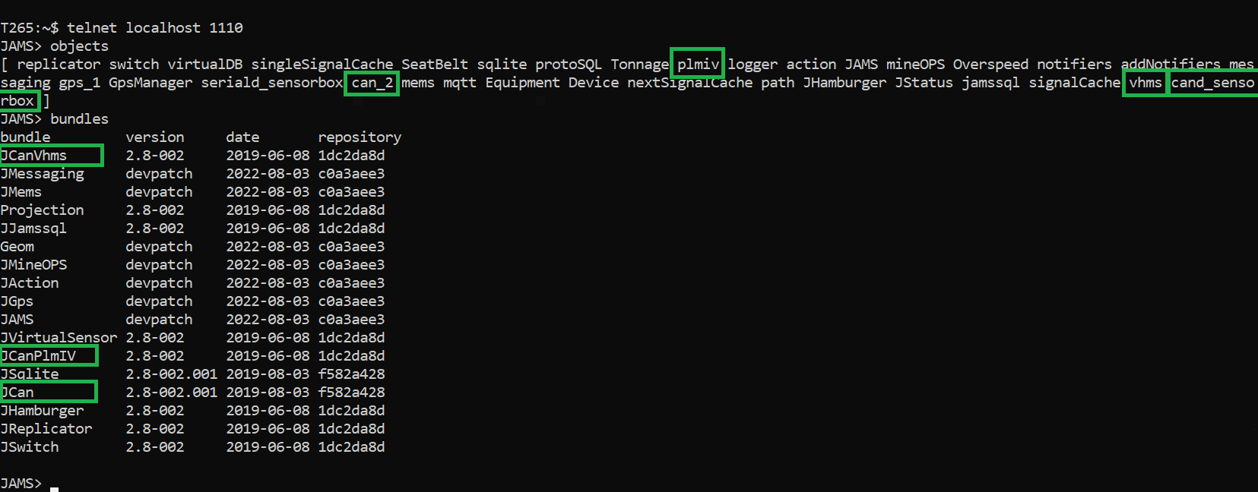
Troubleshooting CAN OEM interfaces
Check that JAMS is loading OEM interface configurations.
JAMS>objects
JAMS>bundles

Slide 13
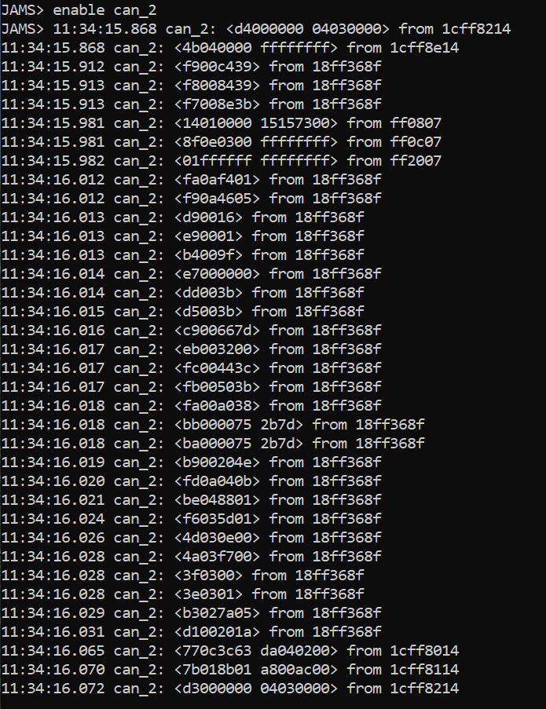
Troubleshooting CAN OEM interfaces
Check that JAMS is receiving data from OEM interface.
JAMS>enable can_2
JAMS

Slide 14
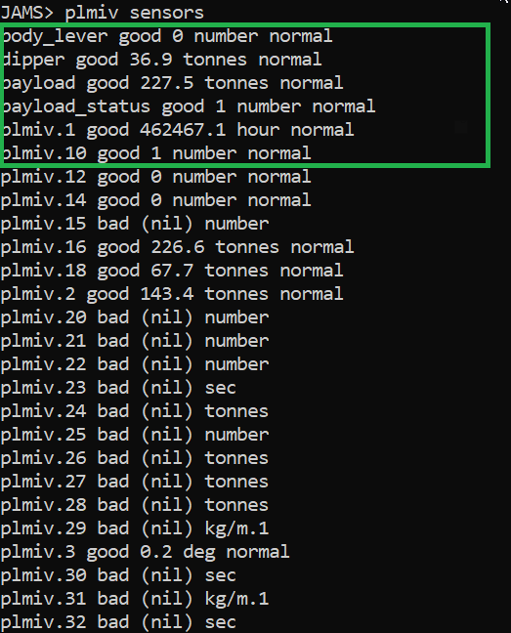
Troubleshooting CAN OEM interfaces
Check that JAMS is reading and translating data from OEM interface.
JAMS>plmiv sensors
JAMS

Slide 15
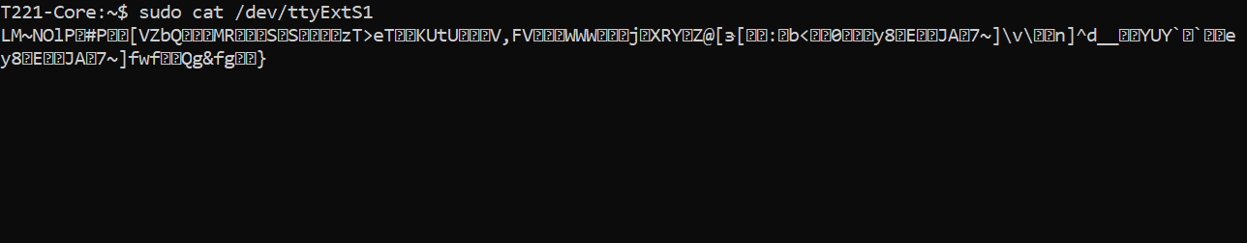
Troubleshooting Serial OEM interfaces
Check that Serial port in Core hub is receiving raw data from OEM interface.
sudo cat /dev/ttyExtS1

Slide 16
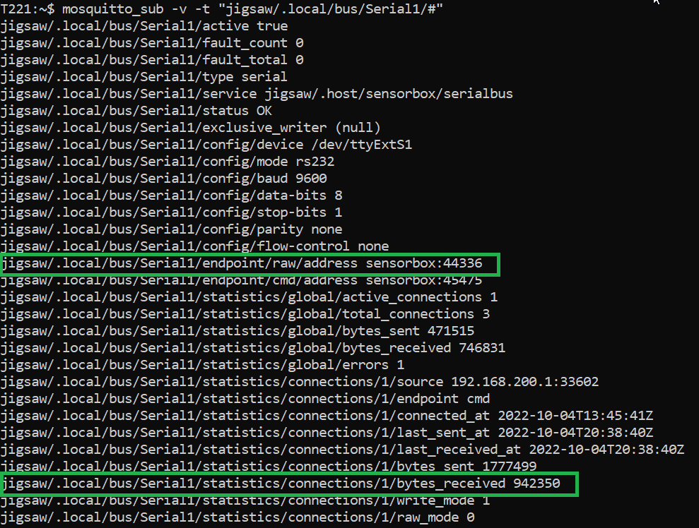
Troubleshooting Serial OEM interfaces
Check that Display9 is receiving data from Core hub.
mosquitto_sub -v -t “jigsaw/.local/bus/Serial1/#”
JAMS

Slide 17
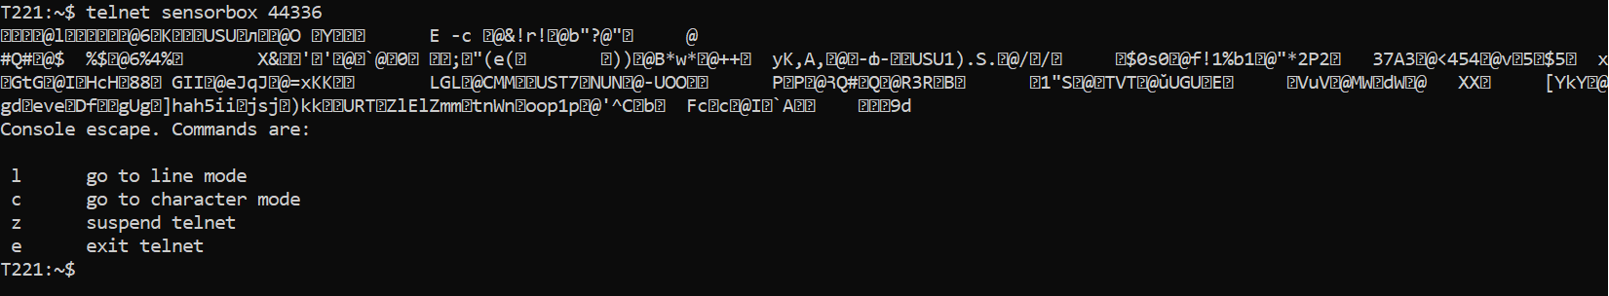
Troubleshooting Serial OEM interfaces
Check that Display9 is receiving data from Core hub.
telnet sensorbox 4436
JAMS

Slide 18
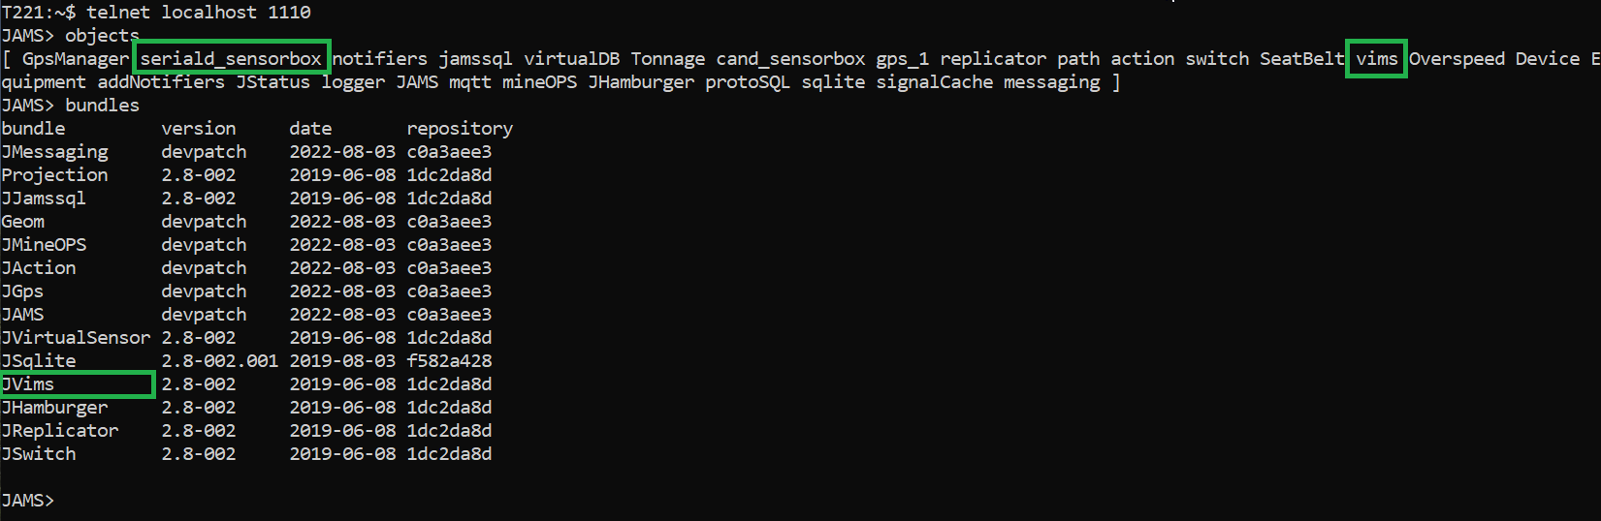
Troubleshooting Serial OEM interfaces
Check that JAMS is loading OEM interface configurations.
JAMS>objects
JAMS>bundles

Slide 19
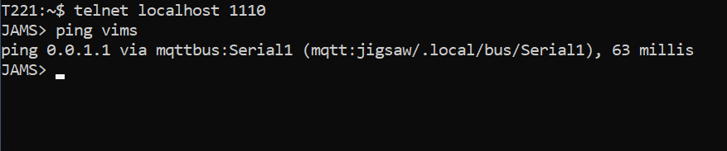
Troubleshooting Serial OEM interfaces
Check that JAMS is receiving data from OEM interface.
JAMS>ping vims
JAMS

Slide 20
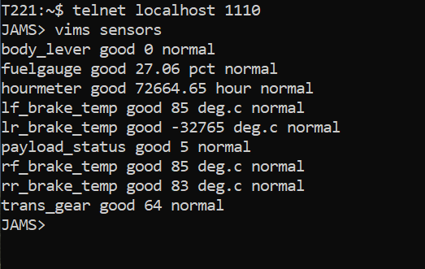
Troubleshooting Serial OEM interfaces
Check that JAMS is receiving and translating data from OEM interface.
JAMS>vims sensors
JAMS

Slide 21
Configuring OEM Interfaces - Questions

Slide 22
Configuring OEM Interfaces - Answers to Questions

Slide 23

THANK
Y
O
U

